Slide 1
PowerUp Parent Orientation

Slide 2
RCSS Vision and Mission Statements
Vision Statement
The Richmond County School system will provide an equitable education for all students to prepare them for life beyond the classroom.
Mission Statement
Building a globally competitive school system that educates the whole child through teaching, learning, collaboration, and innovation.

Slide 3
PowerUp is the name of our 1:1 campaign – it means that every student will have a device (computer). We want to make sure that we answer your questions and to let you know how to find support.

Slide 4
PowerUp Canvas Course
Administrators and Teachers have taken a course in Canvas called PowerUp to help get ready for 1:1.
We are asking our teachers to teach students about Digital Citizenship. Digital Citizenship includes instruction on safety and appropriate behavior when using technology.
We are including some Digital Citizenship information in a course for parents so that you can help your children.

Slide 5
Digital Citizenship
Most of the information on Digital Citizenship comes from a site called Common Sense Media. This includes lessons on protecting your identity, creating strong passwords, how to be a responsible user of technology.

Slide 6
You will need to read the PowerUp Handbook with your student.
After reading the handbook, you will need to fill out the permission form.
The laptop will then be issued to the student.

Slide 7
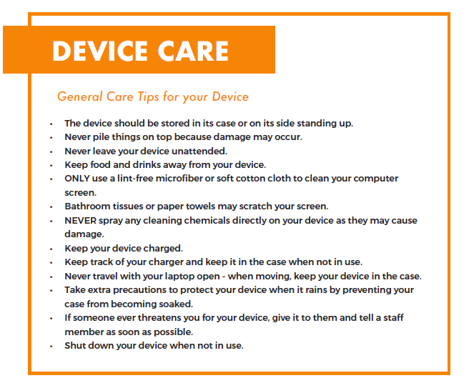
Computer Use at Home
All school rules apply for the home use of your device.
• Keep your device and charging cord away from pets, extreme heat or cold, food, drinks and small children.
• Designate a safe location (off of the floor) where your device can be stored and charged each evening.

Slide 8
PowerUp Handbook
Page 5 – Responsible Use – Your Device Is Intended For Schoolwork ONLY / Login Information Should Be Protected / Use Your Device in a Responsible and Ethical Manner Avoiding Inappropriate or Potentially Unsafe Content: Your device is school property and is being monitored. School personnel have the right to inspect it and your files or electronic communications at any time.
Page 6 – Frequently Asked Questions – Look here before contacting school.
Page 7 – Connecting Your Device to the Internet – See tips.
Page 8 – Cyber Safety – Review safety tips for students and families.
Page 9 – Device Ownership – Review important general information (receiving, returning, loss or theft, fees, etc.).

Slide 9
Computer Information
Pine Hill students will be receiving Chromebooks, one charger, and a case.
Optional annual insurance will be available to help protect families against theft, loss or damage beyond repair.
Insurance cost for a Chromebook is $8.82
If insurance is not purchased, the replacement cost for the computer will be charged if it is lost or damaged beyond repair.
The Chromebook will be inventoried with an asset tag. This is a unique identifier for each device and should not be removed.

Slide 10
School Specifics on Handing Out Computers
In order to get a device, the Technology Agreement form must be signed by student and parent and returned to school.
Students will receive Chromebooks November 15 – 17 during the school day.
Students will be called by homerooms to the gym for device checkout.
Before leaving school, student must sign into Chromebook, so that it can be used at home.

